Slide 1

Spring Boot and JavaFX – can they play together?
JOSIP KOVAčEK, KING ICT

Slide 2
Agenda
Motivation
Technologies
Implementation journey
Demo
Conclusion

Slide 3
Motivation (Problem aka Challenge)
Requirements: Embedded + Desktop project
Closed system infrastructure, few dozens of deploy sites
Needs to work with or without internet
Short deadline, probable long term support after handover
Newly formed small team

Slide 4


Technologies used
Spring Boot
JavaFX 8

Slide 5
Technologies used
Spring Boot
Convention over configuration
All Spring goodness included
Kickstart for new project
Opinionated but allows flexibility
Takes care of server
Simplicity, ease of maintenance and configuration

Slide 6
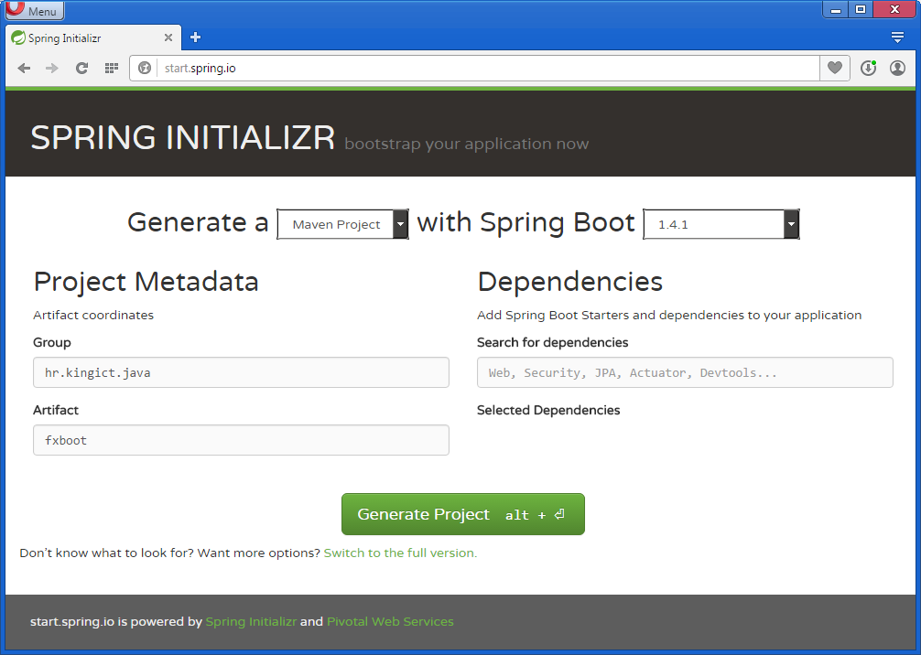

Slide 7
Technologies used
JavaFX 8
Oracle promoted as successor over Swing toolkit
MVC like structure, separation of program and business logic
Cleaner code, easier maintenance
Designed with idea to avoid history pitfalls
Already included in SDK
Gluon Scene Builder

Slide 8
Implementation journey
In search of integration ‘Hello World’
Limited materials on integration available (improving)
JavaFX ignoring spring controller

Slide 9

Demo
Spring Boot Hello World
JavaFX Hello World
Integration
Order of execution
Injection of spring managed controller
Separation of logic

Slide 10
Conclusion
Answer to the question – Yes they can ™
Integration - few challenges, many benefits
Best from both worlds

Slide 11







Conclusion
Outdated information on JavaFX part
Limited (but high quality) JavaFX components ecosystem

Slide 12
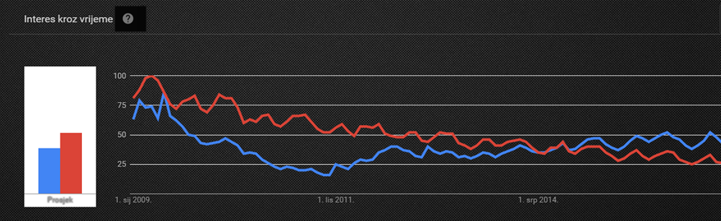
Conclusion
JavaFX still didn’t get required traction, despite all the benefits

Slide 13

Thank you.
Questions?

Slide 14


